Slide 1


2026 Imperial College EEE Project
UK Driverless Vehicle Edge-Case Intelligence Platform

Slide 2


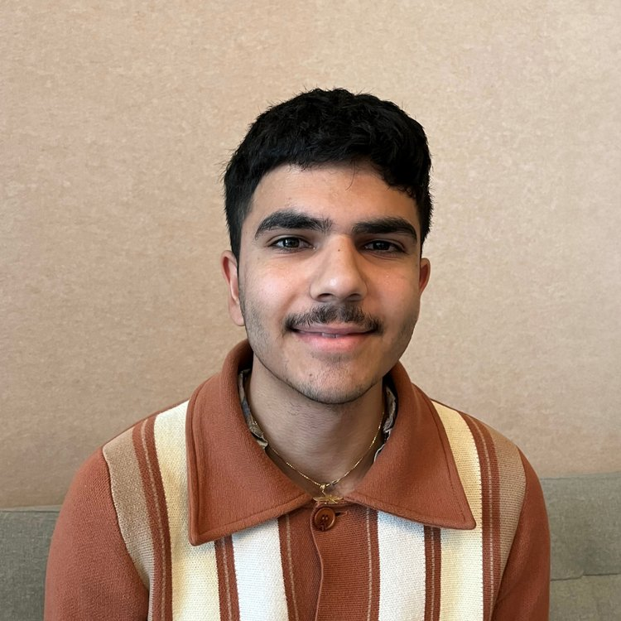
Your Supervisors
Balazs Csuvar Director of Innovation & Net Zero, DG Cities balazs.csuvar@dgcities.com
Imperial College CivEng alumni. Balazs leads the delivery of our innovation projects, solving challenges through the integration of new technologies and holistic thinking. He is a civil engineer by background, with 10 years of international experience as an urban consultant, leading a wide range of projects from developing smart city strategies, planning connected and autonomous mobility, and in local government capacity building.
Nima Karshenas Innovation Consultant, DG Cities nima.karshenas@dgcities.com
Imperial College EEE MEng alumni, Nima previously collaborated with DG Cities on a digital connectivity initiative in Greenwich and worked for a year in industry with PlayStation. Nima contributes his in-depth technical knowledge of AI, Statistics, and Signal Processing to diverse projects that promote social impact and sustainability. He appreciates the broad scope of projects at DG Cities, offering insights and embracing the opportunity to shape a brighter future for cities and communities.

Slide 3

About us
Established in 2015 by the Royal Borough of Greenwich to advance urban innovation.
We provide bespoke consultancy and independent evaluations for local authorities, as well as private and public sector clients.
Our expertise includes decarbonisation strategies, behavioural science programmes, and neighbourhood-level consultancy.
We help councils invest in energy, housing, and transport, piloting and implementing new technologies, digital solutions, and mobility systems.

Slide 4
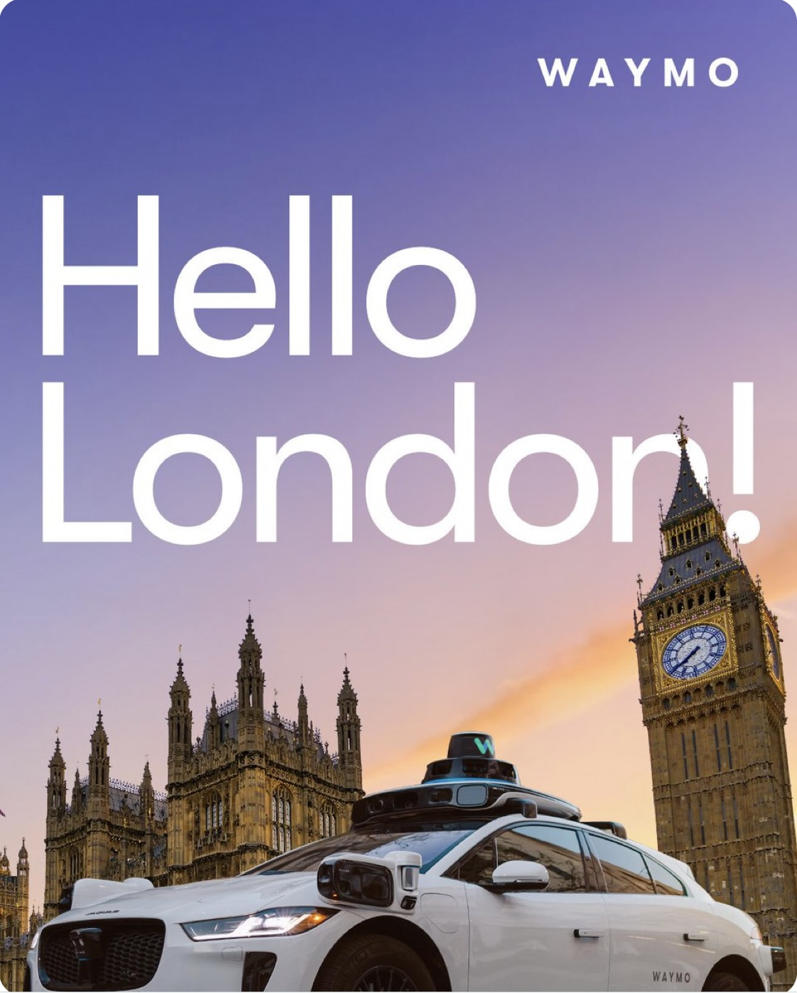
Project Context
Driverless vehicles are moving toward larger-scale UK deployment, with government-backed pilots expected to expand from spring 2026, including services that people can book via an app.
Waymo has publicly signaled plans to expand to London and intends to offer rides in 2026, with trials and validation activity in selected London boroughs.
The core challenge: the UK introduces new driving context and risk compared to US test environments—e.g., dense urban complexity, UK signage/markings, roundabouts, left-hand traffic, narrower streets, and different pedestrian/cyclist patterns.
This project is about building a structured “edge-case intelligence loop”:
capture real-world problematic scenarios (near-misses, collisions, confusion events)
categorise + extract what happened (scene, actors, trigger conditions)
create a searchable knowledge base to support iteration (model fixes, policy, operations, safety case evidence)

Slide 5
Data Overview
Nexar Dashcam Collision Prediction Dataset
1,500 real-world dashcam clips (~40s each) covering collisions, near-collisions, and normal driving, with explicit incident labels.
Open (MIT-style license), suitable for research and model training.
NIDB – Near-miss Incident Database
Large-scale taxi-mounted video dataset focused specifically on near-miss scenarios (pedestrians, cyclists, vehicles).
Research dataset designed for dangerous situation recognition; access typically requested via authors.
SAVeD (ADAS near-miss / crash social-media dataset)
2,119 first-person videos of ADAS-equipped vehicles, with frame-level labels for collisions, evasive manoeuvres, and disengagements.
Built to analyse high-risk edge cases and system failures in automated driving systems.

Slide 6
Technical Deliverables
There are 2 key strands of work that you can put more/less focus on.
1) Machine Learning Model Development
Event type classification: near miss vs minor contact vs collision vs autonomy hesitation/confusion
Actor + interaction extraction: who interacted with whom (vehicle-pedestrian, cyclist, merging conflicts)
Suggested incident categories:
Road geometry: roundabout, multi-lane junction, complex merges, narrow roadsTemporary changes: roadworks, cones, temporary lights, diverted lanes
Vulnerable users: cyclists filtering, pedestrians stepping out, mobility aids, prams
Behavioural edge cases: aggressive cut-ins, illegal turns, sudden braking, informal yielding
Environment: glare/night/rain + reflections + puddles/spray
Multimodal summarisation: generate a short “incident card” from video + user text
Similarity search (should be simple given last step): embeddings to find “cases like this” (build an edge-case library, not just a label bucket)
Test different models: video-transformers (ViT), vs. key-frame extraction + image transformer (Could be open ai out-of-the-box) - What works best? Why?

Slide 7
Technical Deliverables
There are 2 key strands of work that you can put more/less focus on.
2) Online Platform + Data Pipelines
Design an end-to-end system that allows secure submission and analysis.
Simple web interface to upload video + quick manual tags + short narrative + add location
Scalable storage + metadata DB (queryable)
Incident overview visuals (map of incidents with counts, headline figures)
Override automatically assigned tags (track where changes are made and add to ‘training set’.
Admin tools: Manual annotation interface, export for research partners, high-level analytics (types of incidents over time, frequency, spikes in category type (more detailed than what is shown to user.

